Slide 1
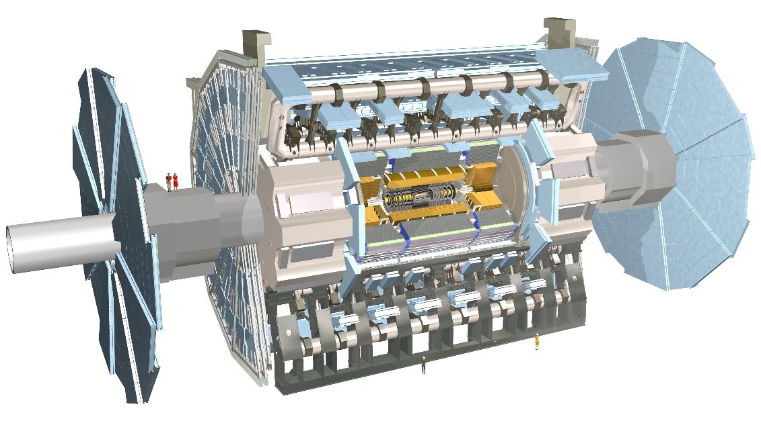


Quantum Hough Transform Algorithm for Charged-Particle Track Reconstruction 09-10-2020 - Constructing Accumulator Space. - GL Search and Maxima finding routine for QHT. - Unknowns and Failure Rates.
Amitabh Yadav Heather Gray HEP Quantum Pattern Recognition - https://hep-qpr.lbl.gov/
Lawrence Berkeley National Laboratory

Slide 2
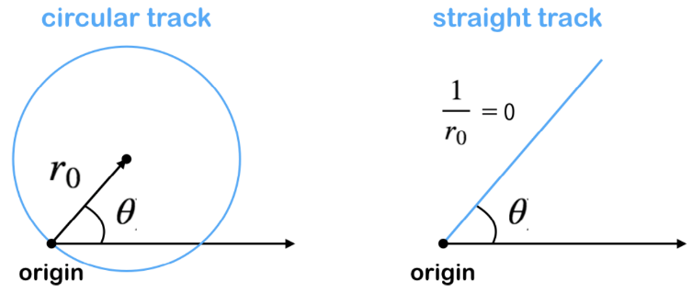
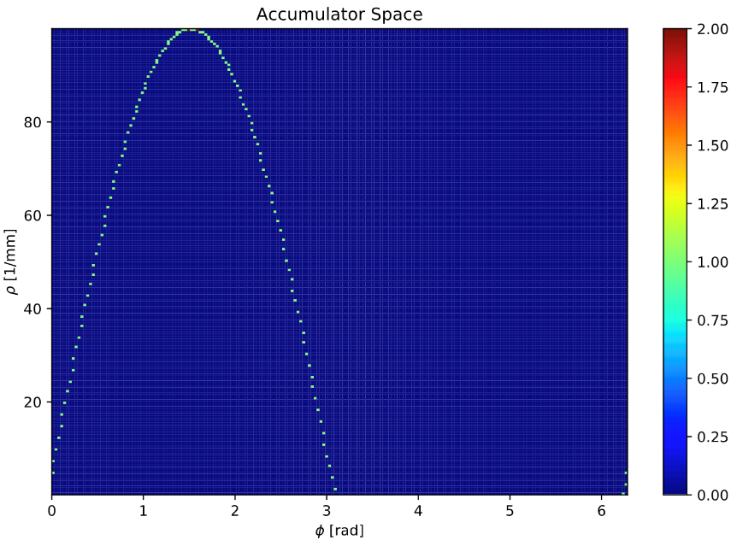
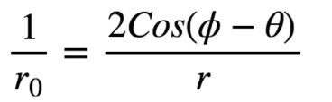
Hough Transform for Circular Tracks
Circle in polar (r, 𝜙) coordinates with center (r₀ , θ):
r = 2r₀ cos(𝜙 - θ)
Voting & Accumulator Space
Construct Accumulator: Let each hit point in polar representation vote.
Loop through each hit point. Voting: For each 𝜙 = [-90, 90] find p for each pixel.
Each point generates a sinusoid in accumulator space while incremental voting at each bin in a matrix (accumulator matrix).
Hough Transform for a Hit:
Transform
Hit (r, 𝜙)
One hit with coordinates (r, 𝜙)
Ref.: TrackML particle tracking challenge: https://www.kaggle.com/c/trackml-particle-identification/overview

Slide 3

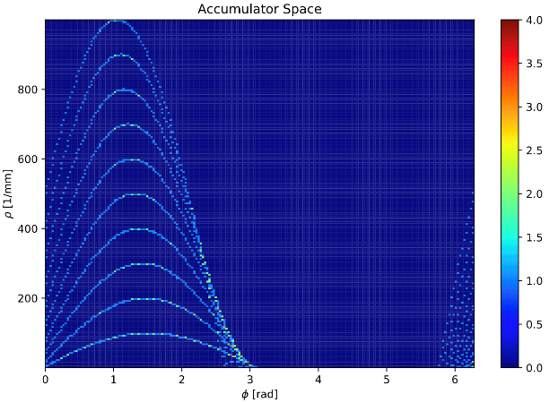
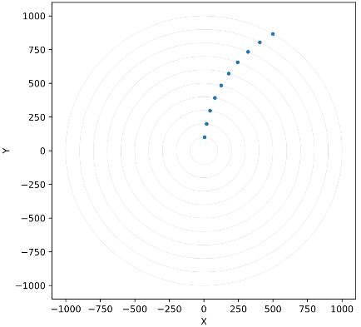
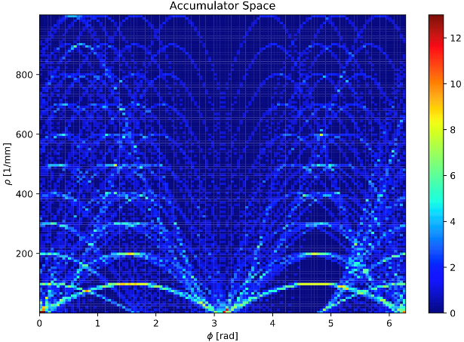
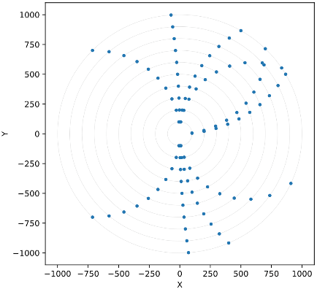
Hough Transform for Circular Tracks
On a Toy Model Detector
Recognized
Track
Tracks
One Track
Event
Recognized Tracks
( local maxima / hot bins )

Slide 4
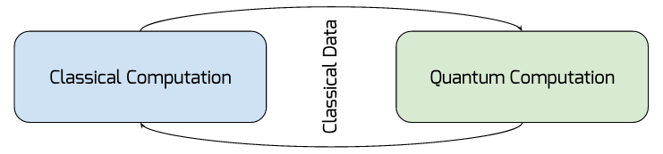

Quantum Hough Transform
Grover-Long Algorithm for Search
Hybrid Quantum/Classical Algorithm
Quantum Maxima Algorithm^{[1]}
Grover-Long (GL) Algorithm: Finite Search for Maxima in Accumulator Space.
Close estimates of the ratio of the number of solutions* M and the searched space N, renders success probability close to 100%.
[1 ] [CQGW19] An Optimized Quantum Maximum or Minimum Searching Algorithm and its Circuits. (2019) https://arxiv.org/abs/1908.07943
* not a necessary condition
Notes:
2 slides

Slide 5
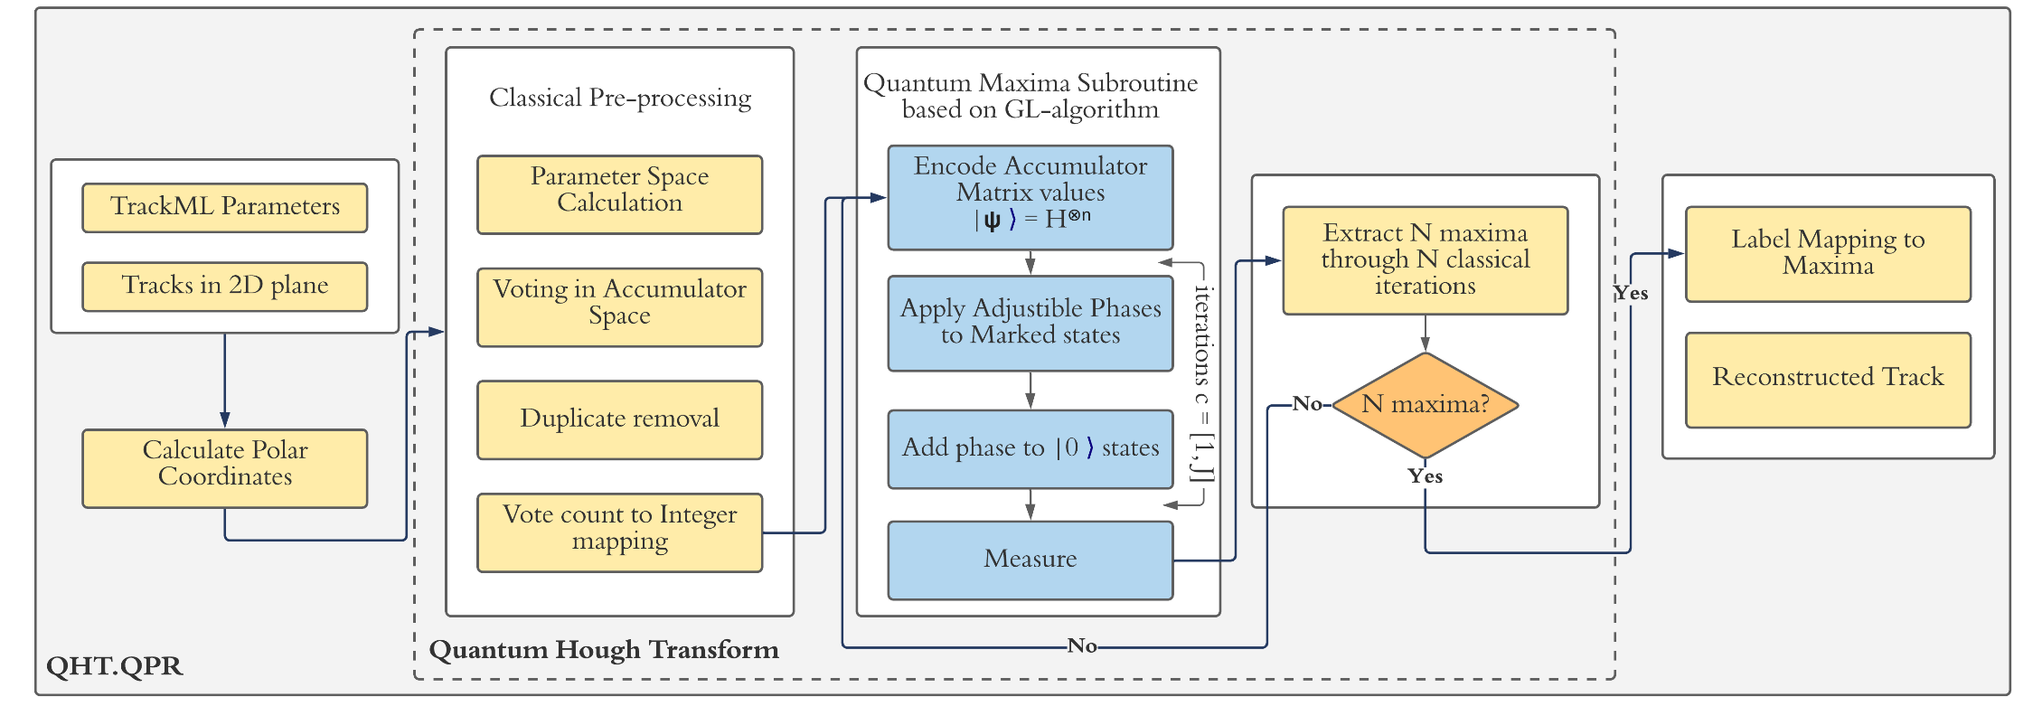
Quantum Hough Transform
Grover-Long Algorithm for Search on a Toy Model Detector
Algorithm Flowchart
Notes:
2 slides

Slide 6
Quantum Hough Transform
Grover-Long Algorithm for Search on a Toy Model Detector
Algorithm Flowchart
Construction of Classical Accumulator Space
Quantum Hough Transform/Maxima Finding
Label Mapping and Reconstruction
Notes:
2 slides

Slide 7
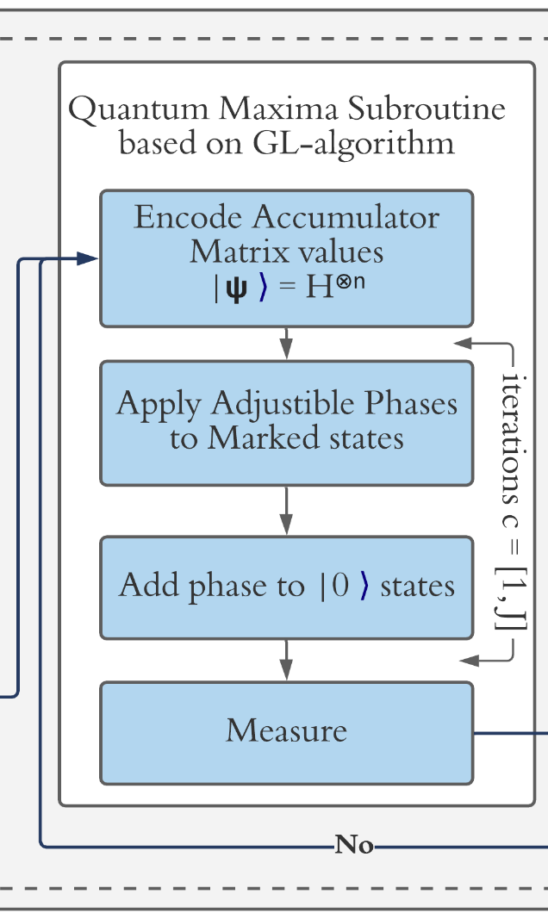
Quantum Hough Transform
Grover-Long Algorithm for Search on a Toy Model Detector
Algorithm Flowchart
Construction of Classical Accumulator Space
Quantum Hough Transform/ Maxima Finding
Label Mapping and Reconstruction
Notes:
2 slides

Slide 8
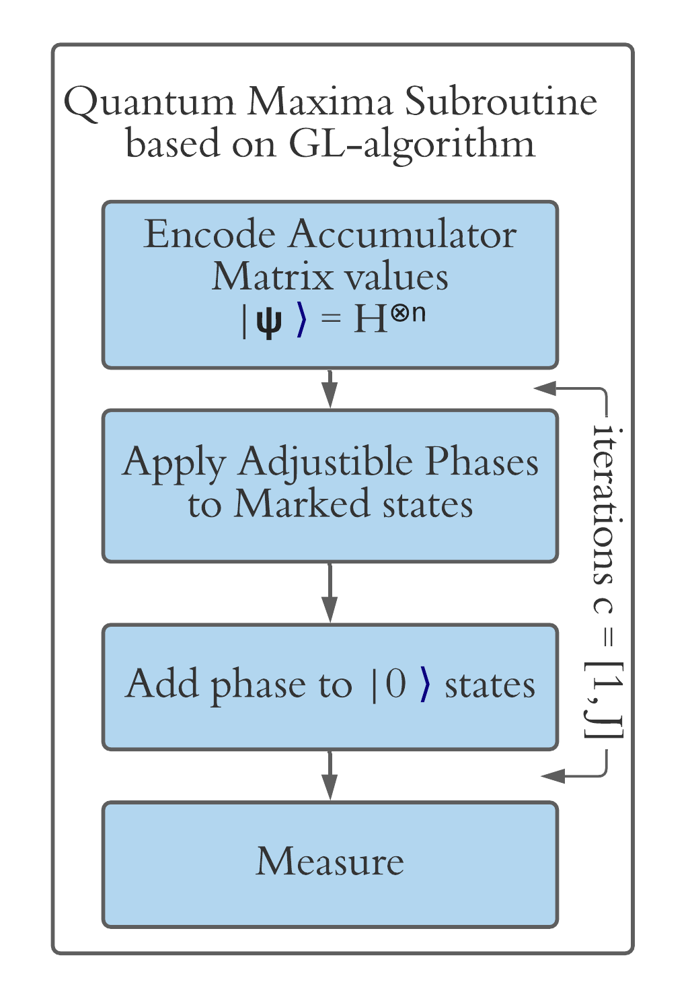
Quantum Hough Transform
GL Subroutine and Accumulator Mapping
Quantum Hough Transform = Quantum Maxima Finding for detecting concurrent lines in Parameter Space.
The number of local maxima corresponds to the number of tracks in a given accumulator space.
Initial State Preparation: Encode Accumulator matrix values.
Each data value must be a: distinct, positive, integer.
Each accumulator value is represented by a binary string.
Orthonormal basis states of |Ψ⟩ store data value, where |Ψ⟩ is the initial state. State preparation: log2(N) steps.
For N ∈ 2^{n} where n is #qubits. then, |Ψ⟩init. = H^{⊗n}
One-to-one mapping between a data value and it’s index.
Notes:
2 slides

Slide 9
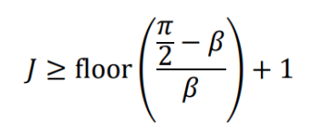
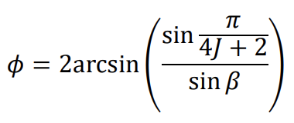
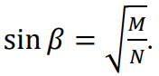
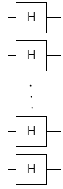
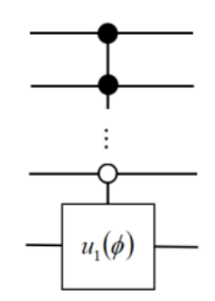
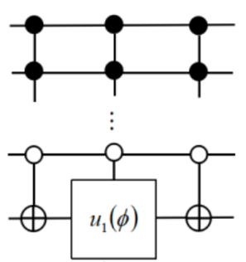
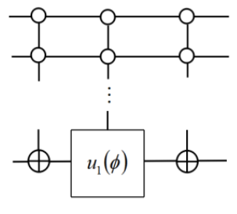
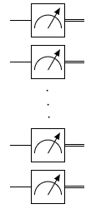
Quantum Hough Transform
GL Subroutine and Accumulator Mapping
Grover-Long Subroutine
Calculate Iteration Parameters and Arbitrary phase values.
GL = -WI₀W⁻¹O where, W, I₀ and O are unitary operators. (next slide)
Where,
Number of Grover Iterations
Adjustable phase added to |0⟩ and marked states upon each Grover Iteration
Iterations = [1,J]
q[n-1]
q[n-2]
q[1]
q[0]
W
O
W⁻¹
I₀
W
M
Notes:
2 slides

Slide 10
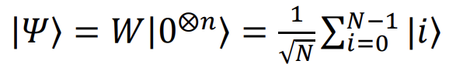
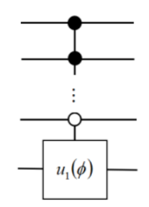
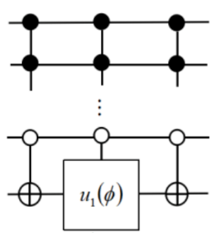
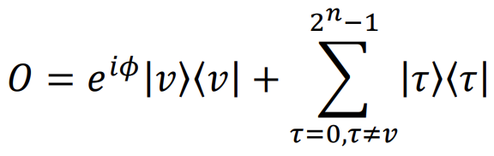
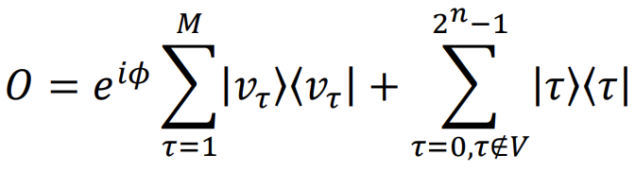
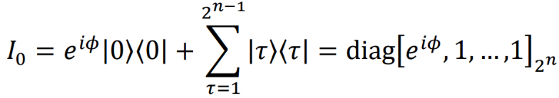
Quantum Hough Transform
GL Subroutine
GL = -WI0W⁻¹O where, W, I0 and O are unitary operators.
O operator
Create Superposition
for Odd states
for Even states
Add rotation phase to marked states |ντ⟩ state.
I0 operator
Add adjustable rotation phase to |0⟩ state.
q[n-1]
q[n-2]
n qubits
q[0]
Notes:
2 slides

Slide 11
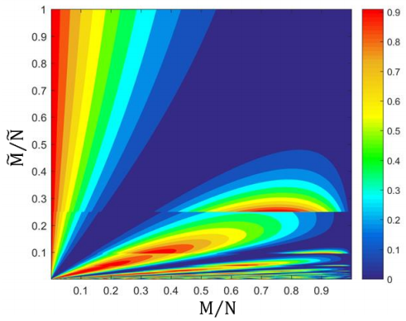
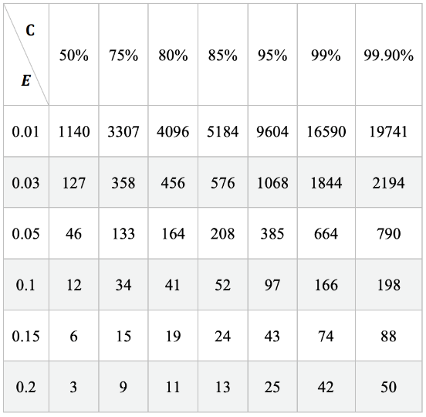
Finding Tracks without specifying M (= number of tracks to be detected)
Finite Search: GL interrupt condition is handled by an variable c <type: int> which is independent of the database size. The failure rate decreases exponentially as c increases linearly.
Estimated M𝑀̃ and N𝑁̃ are used and all possible states are marked. Thus, each orthogonal basis state stores a value.
Failure Rates:
Choice of Interrupt condition, c
Failure rate varies between 0.0%-0.9% by the choice of M𝑀̃ and N𝑁̃ -- more analysis required.
Challenge: Failure rate increases with data size growing, due to the unknown exact values of M and N. Mitigation: Using the minimum sample size to estimate the ratio of the number of solutions and the database size 𝑀/𝑁, we can obtain exact parameters of Grover-Long algorithm.
Confidence Level
Classical Recons. Eff.
16-20 qubits
Acceptable Error
Current QHT
8 qubits
Minimum Sample Size
Notes:
2 slides

Slide 12
Conclusion
Quantum Algorithm for Maxima/Minima finding {O(√N) + O(k.log2(N) for state preparation} + {classical processing}.
Only Maxima subroutine implemented. Uses one-to-one digitized mapping with amplitude of quantum states.
In our case, the parameter space, (1/r0, φ) is constructed classically. So, there is an improvement only in terms of speed of search operation.
Returns a 2D array each row containing corresponding hits of the identified tracks.
Correctness - Initial analysis of failure rate.
Next Steps:
Classical Accumulator space construction does not render speed up in terms of memory complexity. — Start from scratch, create superposition hits and of (1/r₀ , θ) space ^{[V13 for n-dim]}. — Construct accumulator space superposition in parts, that can be based on detector geometry.
[CQGW19] An Optimized Quantum Maximum or Minimum Searching Algorithm and its Circuits. https://arxiv.org/abs/1908.07943
[V13] K. M. Varadarajan, Quantum Hough Transform, GraphiCon’2013 (2013)

Slide 13
fin.

Slide 14
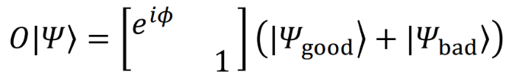
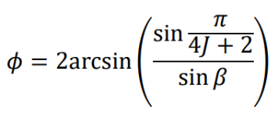
Extras: Quantum Maxima Finding using GL Algorithm
GL subroutine: GL = -WI0W⁻¹O : where, W, I0 and O are unitary operators.
Step 1: apply phase to marked states: O operator
Step 2: -WI0W⁻¹ operator
Step x: GL operator overall, can be expressed as follows:
Good and Bad states i.e. Marked and Unmarked states are represented as:

Slide 15
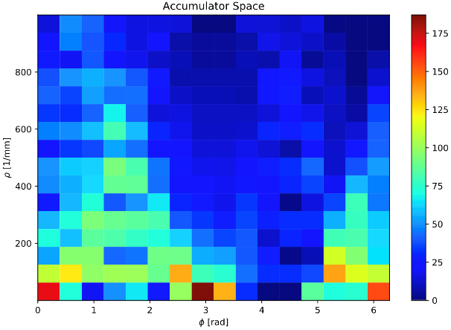
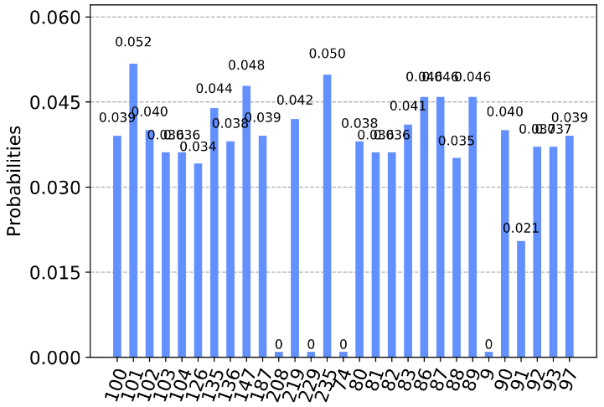
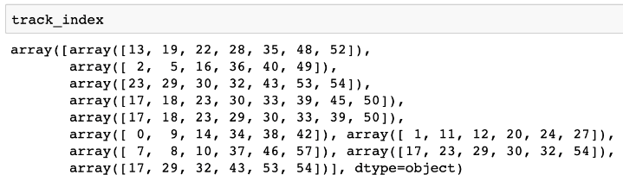
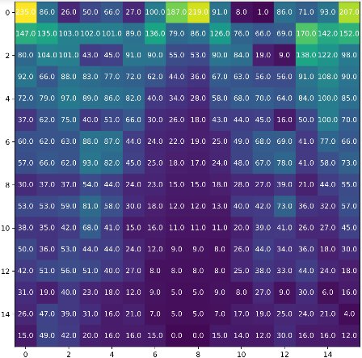
Quantum Maxima Finding
Results: Local Maxima Detection using Grover-Long Algorithm
Probability of detecting all non-zero marked states*
Quantum
Superposition
Accumulator Space for 10 tracks
10 maxima values^
N iterations = N maxima where, N is provided as input.
vote counts
8-qubit simulation
#bins up to 2⁸ = 256, time = 58.6s
* Updates Iteratively upon each maxima extraction.
Accumulator Matrix for 10 tracks
^ detected through classical HT
Notes:
2 slides

Slide 16

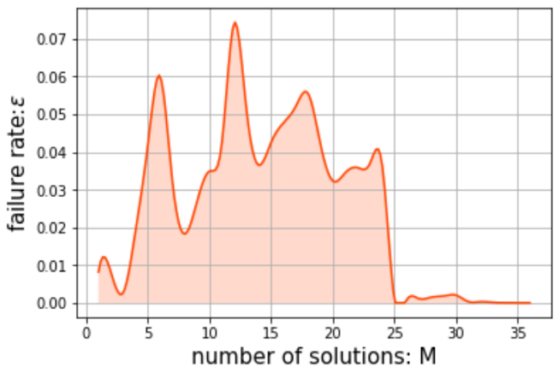
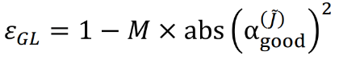
Quantum Maxima Finding
Results: Local Maxima Detection using Grover-Long Algorithm
Failure Rate as number of Marked States:
Number of Grover-Long iterations can be fixed with iterator c.
Scalable: GL failure rate is less than 10%.
Can be improved with even higher number of marked states.
Confidence Level
Classical Recons. Eff.
16-20 qubits
Acceptable Error
Current QHT
8 qubits
8-qubit simulation:
number of marked states = 25
Minimum Sample Size
Theoretical Error Rate =
Minimum Sample Size
[CQGW19] An Optimized Quantum Maximum or Minimum Searching Algorithm and its Circuits. https://arxiv.org/abs/1908.07943
Notes:
2 slides

Slide 17
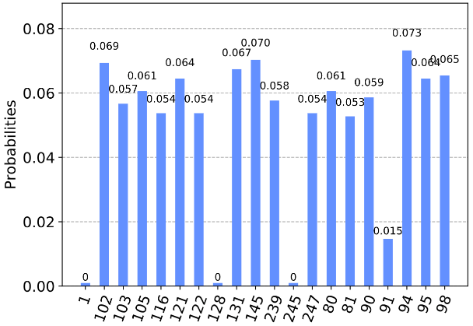
Quantum Maxima Finding
Results: Local Maxima Detection using Grover-Long Algorithm
Failure Rate as number of Marked States = 17
8-qubit simulation:
number of marked states = 17
Theoretical Error Rate =
Minimum Sample Size
Notes:
2 slides

Slide 18
Extras: Data Fitting
Extras: Quantum Encoding for Accumulator Matrix
- Quantum embeddings for machine learning [2020]
https://arxiv.org/abs/2001.03622, https://arxiv.org/abs/1803.07128, https://arxiv.org/abs/1804.11326
-A divide-and-conquer algorithm for quantum state preparation [2020]
https://arxiv.org/abs/2008.01511
Discrete Fourier transform for Pattern Classification [2014]: http://citeseerx.ist.psu.edu/viewdoc/download?doi=10.1.1.1018.1299&rep=rep1&type=pdf
uses classical Fourier Transform to implement nearest-neighbor based classifier.
Quantum Support Vector Machine for classification [2013]:
https://arxiv.org/abs/1307.0471
Quantum Data Fitting [2012]
https://arxiv.org/abs/1204.5242

Slide 19
Modern Quantum Algorithmic Landscape for Gate Model QC (...lots to Explore!)
Quantum Machine Learning
Bayesian Deep Learning
Quantum Tensor Networks
Quantum Neural Networks
Quantum Principal Component Analysis
Simulation
Variational Quantum Eigensolver (VQEs) and 𝜶-VQEs
QITE/QLanczos
Thermal Averages: METTS Algorithm, Quantum Importance Sampling
Unitary Quantum Dynamics,
Field Theory Simulation, HEP Simulations etc.
Quantum Graph Theory/Other Approaches
Quantum Random Walks
Quantum Monte Carlo
Quantum Probably Approximately Correct
Grover’s Search
Scientific Computing/Mathematical Methods Finite Element Methods, Partial Differential Equations, Poisson Solver
Quantum Linear System Algorithms/HHL
Quantum Support Vector Machine
Quantum Phase Estimation
Quantum Fourier Transform
Optimization
Quantum Alternating Ansatz Algorithms (QAAA) - QAOA and Hamiltonian-based QAOA
Quantum Annealing (on D-Wave)
Quantum-Inspired Classical Algorithms
Recommendation Systems
Notes:
Motivation: First and Second Quantum Revolution (JP Dowling’s Paper)
Present Day applications (Chemistry/Physics Simulation, Optimization, ML...)
Modern Methods used in QC - the landscape

Slide 20
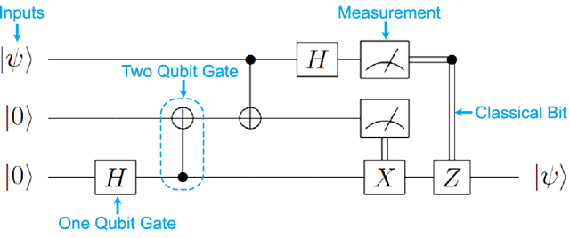
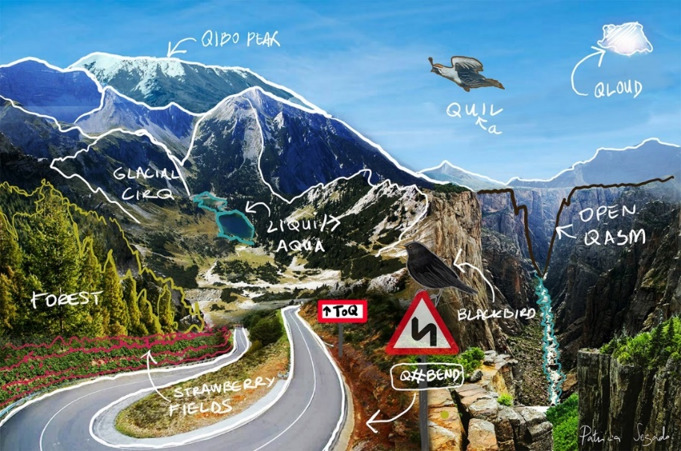
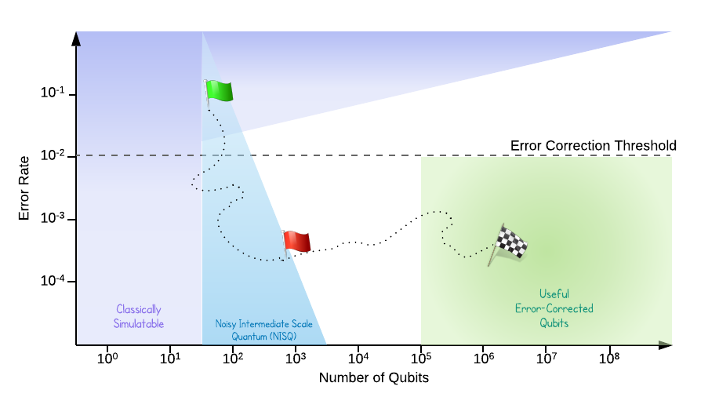
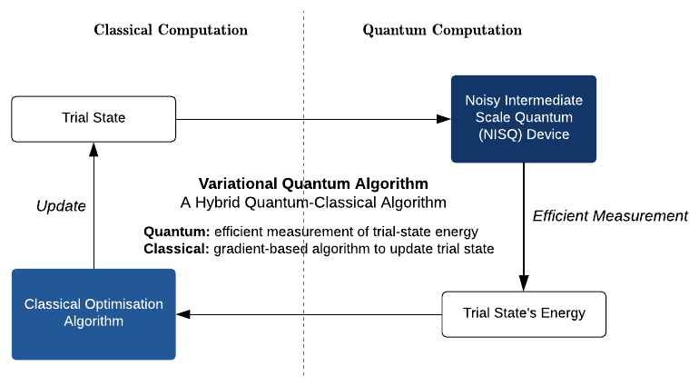
Introduction
𝖡𝖰𝖯 ⊆ 𝖯𝖲𝖯𝖠𝖢𝖤
Circuit Model QC
Universal Quantum Computing
Solovay-Kitaev Theorem^{[KY97]}
Quantum Computing Applications Approach
Perfect Qubits
Erroneous Qubits in NISQ-era - Test algorithmic bounds of error-tolerance, - Pauli Frames, - Temporary Quantum Registers and SWAP gates, - Small (distance) EC Codes etc.
Ref: https://ai.googleblog.com/2018/03/a-preview-of-bristlecone-googles-new.html
QPU vs Simulators platform
Quantum accelerator model.
Good QC Packages out there for modern QC methods: (QISKit, Forest, Xanadu PennyLane, Entropica, QuEST, quantumSim, Project-Q, QX… to name a few)
Ref.: Kitaev, Yu, Quantum computations: algorithms and error correction, Russian Mathematical Surveys(1997)
Notes:
Motivation: First and Second Quantum Revolution (JP Dowling’s Paper)
Present Day applications (Chemistry/Physics Simulation, Optimization, ML...)
Modern Methods used in QC - the landscape

Slide 21
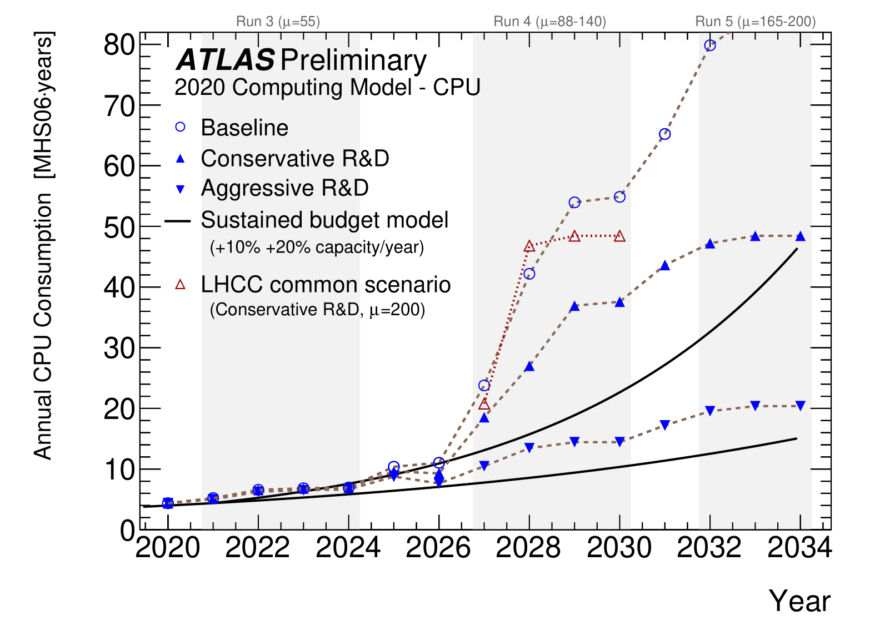
Hough Transform for Tracking
Why Hough Transform?
Tracking: a key computational challenge.
Simple formulation.
P.V.C. Hough (’62): “…adaptable to the study of subatomic particle tracks…”
Notes:
Hough Transform Algorithm flow.
Bottleneck in (classical) Hough Transform?
Quantum Advantage/Rationale? Exponential State Space + Spookiness (aka Entanglement).

Slide 22
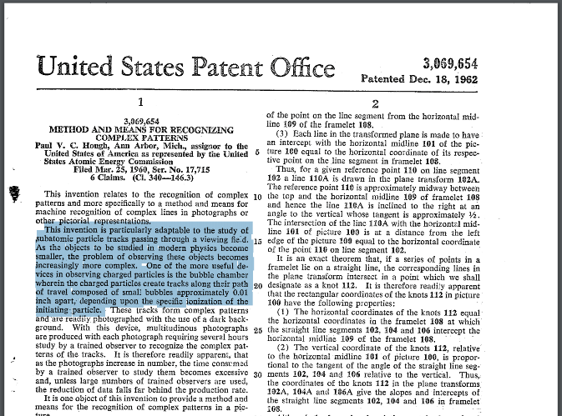
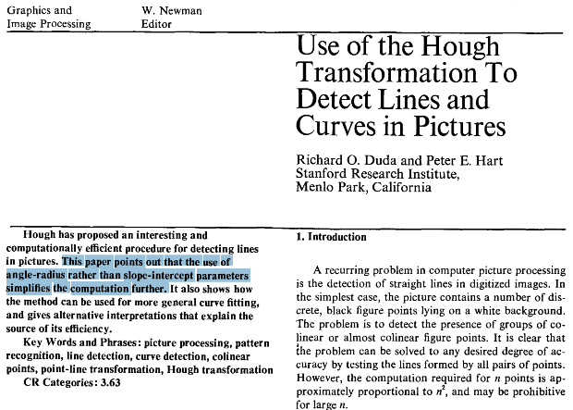
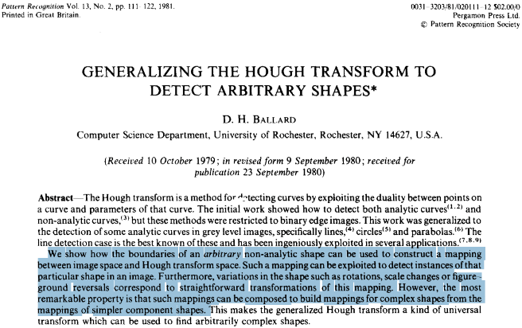
Hough Transform for Tracking
Why Hough Transform?
Tracking: a key computational challenge.
Simple formulation.
P.V.C. Hough (’62): “…adaptable to the study of subatomic particle tracks…”
P.V.C. Hough (1962)
Hough Transform is a method of finding groups of collinear points by a mathematically equivalent problem of finding concurrent lines. This method involves transforming each of the figure points into a curve in a parameter space.
R.O. Duda, P.E. Hart (1972)
Uses angle-radius rather than slope-intercept parameters to simplify computation.
D.H. Ballard (1980) - Generalized Hough Transform for Arbitrary Shapes
Uses n-Dimensional parameter space for arbitrary shapes.
Detects simple and complex shapes.
Hough Space
Notes:
Hough Transform Algorithm flow.
Bottleneck in (classical) Hough Transform?
Quantum Advantage/Rationale? Exponential State Space + Spookiness (aka Entanglement).

Slide 23
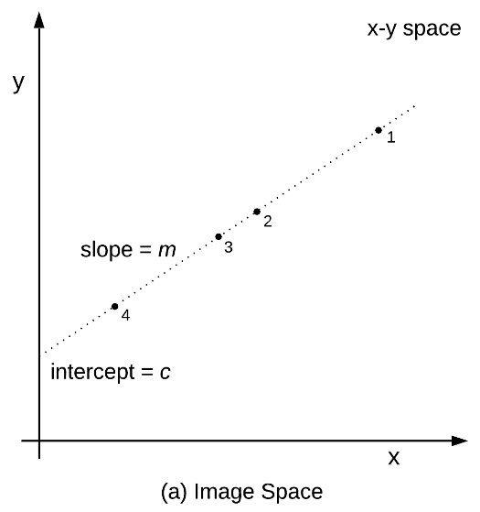
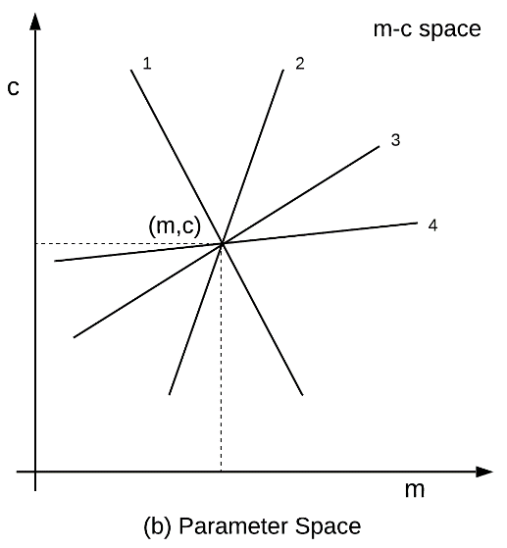
Hough Transform for Linear Track
y = mx + c
Parameter Space
A hit in xy-space is represented as a line in mc-space.
Multiple hits renders multiple lines in parameter space.
The intersection (m, c) represents the line connecting the hits.
Accumulator Space
Lets each hit point vote by discretizing the parameter space.
Voting allows us to give more weightage to hit points that fall along a line.
Track Detection
The intersections are detected by means of voting in an accumulator matrix and detecting the local maximum.
Hough Space
Notes:
Hough Transform Algorithm flow.
Bottleneck in (classical) Hough Transform?
Quantum Advantage/Rationale? Exponential State Space + Spookiness (aka Entanglement).

Slide 24
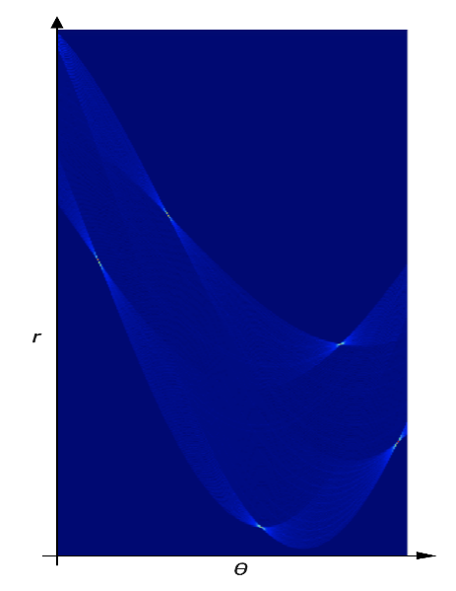
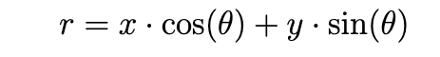
Hough Transform for Linear Track
Vertical lines: m, c = unbounded. This implies, accumulator needs infinite space.
Mitigation: a different representation of the transformation. Point in (x, y) space is represented by a sinusoid in (r, θ).
Line in polar coordinates:
Accumulator space for 5 straight lines
r = x cos(θ) + y sin(θ)
where,
θ ∈ [-90⁰ , +90⁰]
r = [0, len(xy-spacediagonal)]

